Slide 1
Operating System Services
Operating System Services
Provides an environment for the execution of programs.
Provides certain services to:
programs
Users of those programs
Basically, two types of services:
** Set of operating-system services provides functions that are helpful to the user.
**Set of operating-system functions for ensuring the efficient operation of the system itself via resource sharing
Dept. of CSE(CS), MSRIT

Slide 2
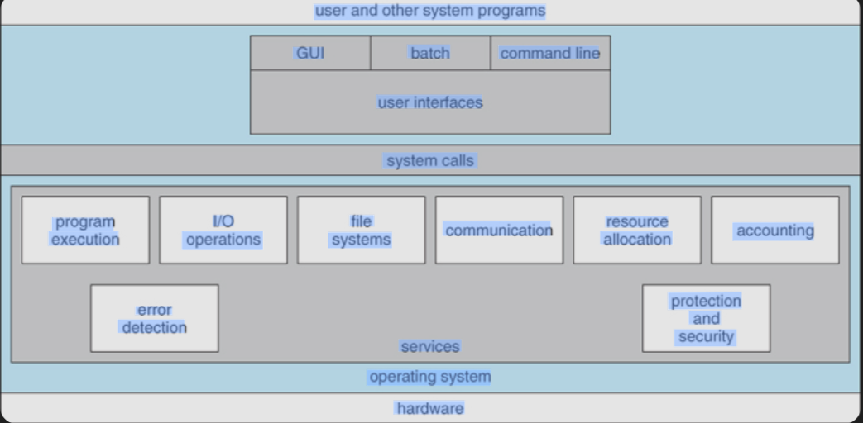
Operating System Services
Dept. of CSE(CS), MSRIT

Slide 3
Operating System Services
An operating system provides an environment for the execution of programs.
It provides certain services to programs and to the users of those programs.
The specific services provided, of course, differ from one operating system to another, but we can identify common classes.
These operating-system services are provided for the convenience of the programmer, to make the programming task easier.
The above fig shows various operating system services and how they interrelate.
Dept. of CSE(CS), MSRIT

Slide 4
Operating System Services
OS Services Helpful to the user
User Interface-Almost all operating systems have a user Interface(UI). Several forms:
Command-Line(CLI)—uses text commands and a method for entering them(say, a keyboard for typing in commands in a specific format with specific options)
Graphics User Interface(GUI)—The interface is a window system with a pointing device to direct I/O, choose from menus, and make selections and a keyboard to enter text..
Batch Interface—Commands and directives to control those commands are entered into files, and those files are executed.
Some systems provide two or all 3 variations.
Dept. of CSE(CS), MSRIT

Slide 5
Operating System Services
OS Services helpful to the user:
Program Execution-The system must be able to load a program into memory and to run that program, end execution, either normally or abnormally(indicating error).
I/O operations—A running program may require I/O, which may involve a file or an I/O device.
File-System Manipulation-Programs need to read and write files and directories, create and delete them, search them, list file information, permission management
Dept. of CSE(CS), MSRIT

Slide 6
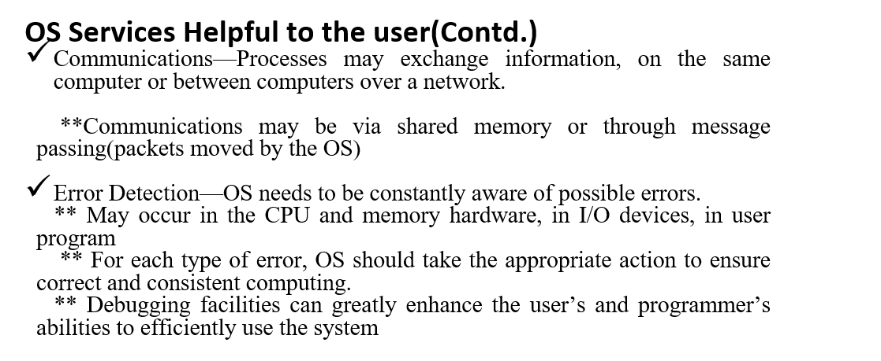
Operating System Services
Dept. of CSE(CS), MSRIT

Slide 7
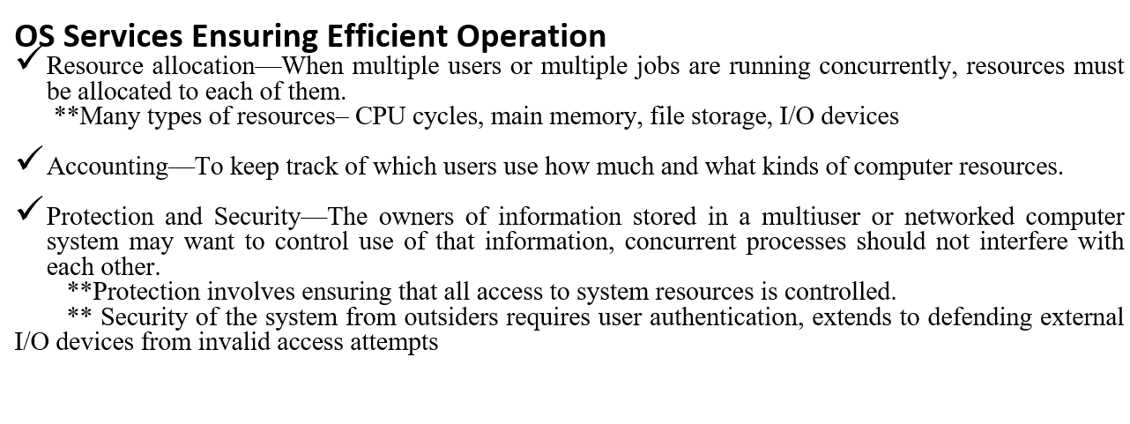
Operating System Services
Dept. of CSE(CS), MSRIT

Slide 8
User Operating System Interfaces
One approach for os interface is command-line interface, or Command interpreter, that allows users to directly enter commands to be performed by the operating system.
The other allows users to interface with the operating system via a graphical user interface, or GUI.
Command Interpreters: (CLI)
CLI allows users to directly enter commands to be performed by the operating system.
Some operating systems include the command interpreter in the kernel.
Some operating systems, such as Windows and Unix, treat the command interpreter as a special program that is running when a job is initiated or when a user first logs on.
On systems with multiple command interpreters to choose from the interpreters are known as Shells.
The main function of the command interpreter is to get and execute the next user specified command.
Sometimes command built-in, sometimes just names of programs
** If the latter, adding new features doesn’t require shell modification.
Dept. of CSE(CS), MSRIT

Slide 9
User Operating System Interfaces
Graphical User Interfaces(GUI)
User-friendly desktop metaphor interface
&& Usually mouse, keyboard and monitor
&& Icons represent files, programs, actions etc
&& Various mouse buttons over objects in the interface cause various actions(Provide information, options, execute function, open directory(known as a folder)
&& Invented at Xerox PARC
Many systems now include both CLI and GUI interfaces
&& Microsoft Window is GUI with CLI “command” shell
&& Apple Mac OS X is “Aqua” GUI interface with UNIX kernel underneath and shells available.
&& Unix and Linux have CLI with optional GUI interfaces(CDE, KDE, GNOME)
Dept. of CSE(CS), MSRIT

Slide 10
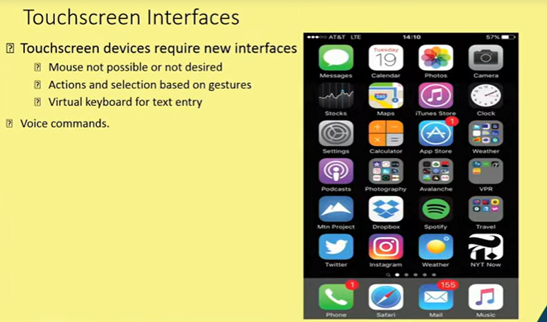
User Operating System Interfaces
Dept. of CSE(CS), MSRIT

Slide 11
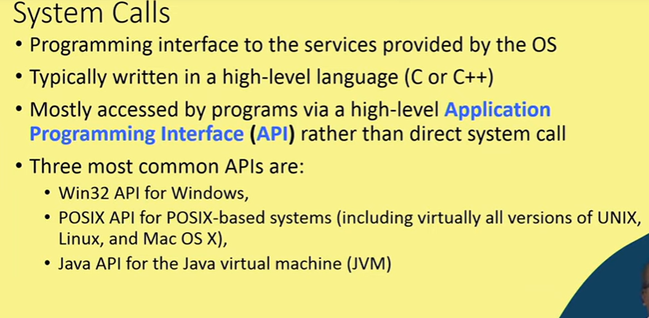
System Calls
Dept. of CSE(CS), MSRIT

Slide 12
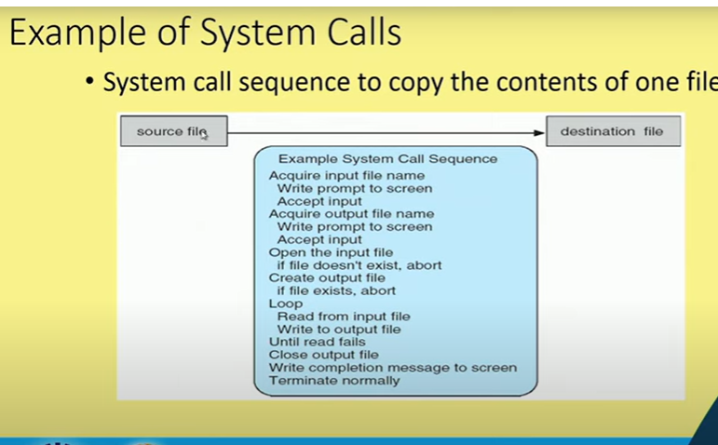
System Calls
Dept. of CSE(CS), MSRIT

Slide 13
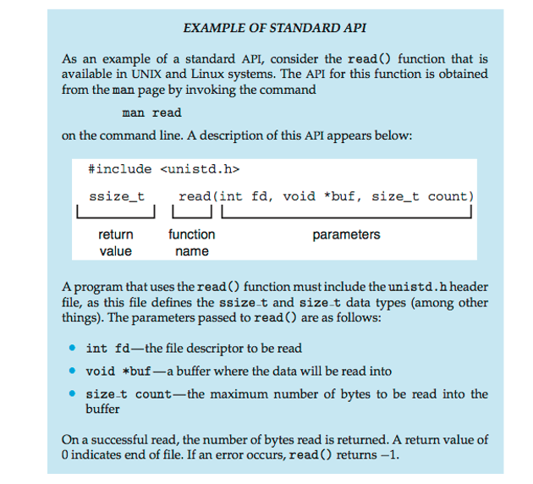
System Calls
Dept. of CSE(CS), MSRIT

Slide 14
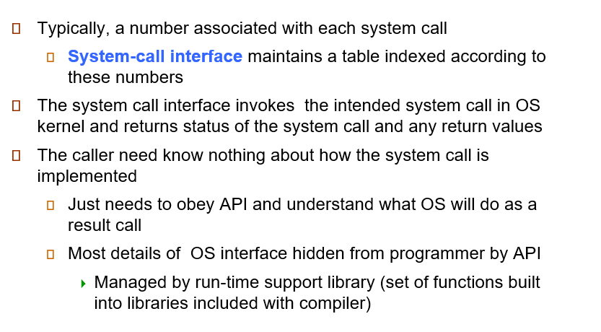
System Call Implementation
Dept. of CSE(CS), MSRIT

Slide 15
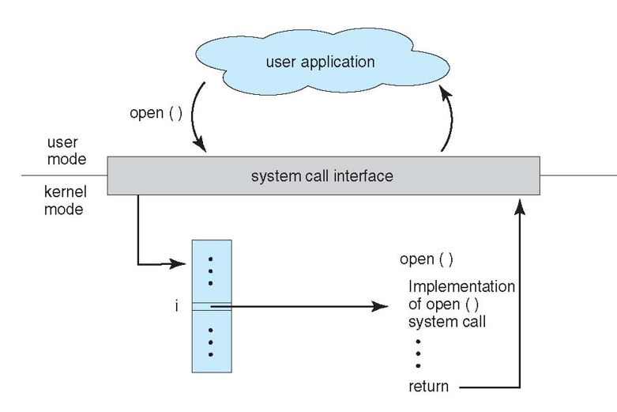
API-System Call OS Relationship
Dept. of CSE(CS), MSRIT

Slide 16
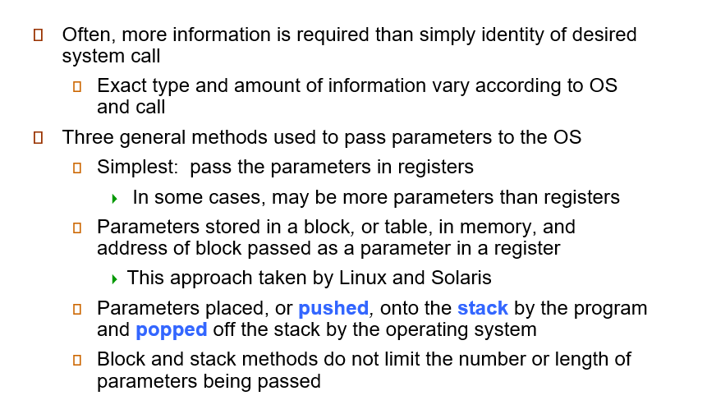
System Call parameter Passing
Dept. of CSE(CS), MSRIT

Slide 17
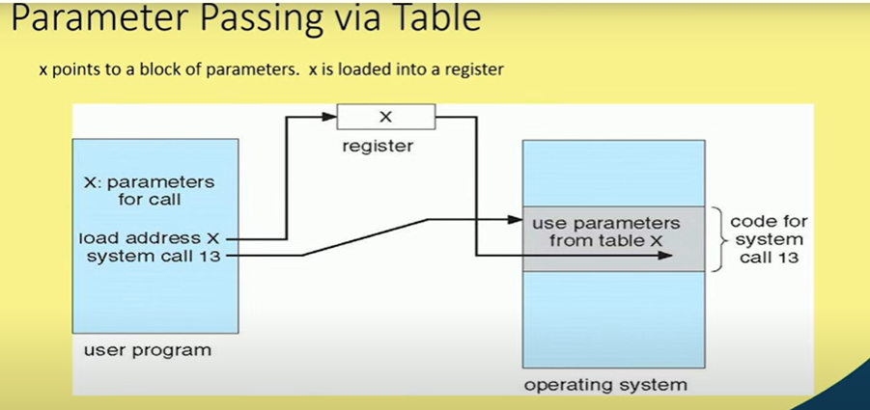
System Calls
Dept. of CSE(CS), MSRIT

Slide 18
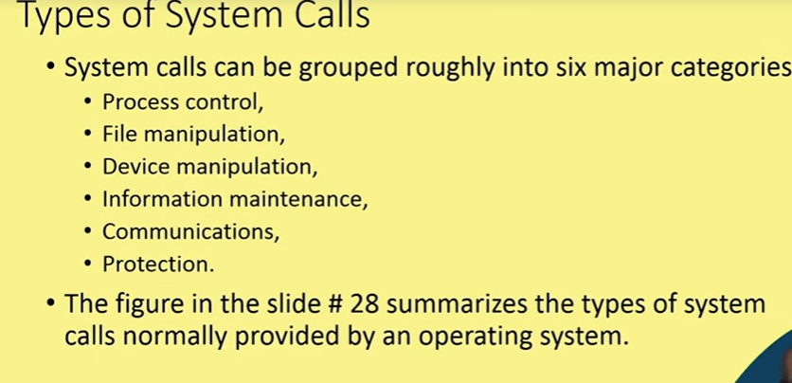
Types of system calls
Dept. of CSE(CS), MSRIT

Slide 19
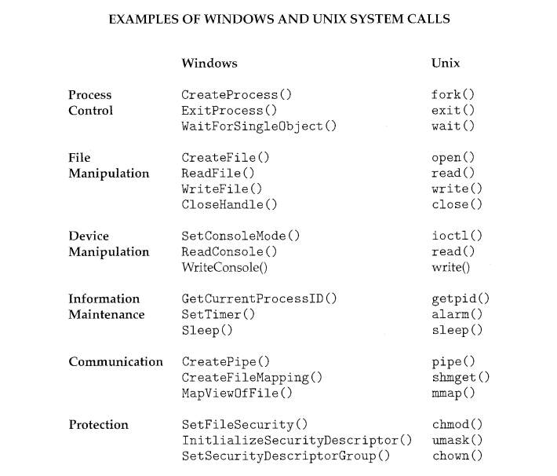
Types of system calls
Dept. of CSE(CS), MSRIT

Slide 20
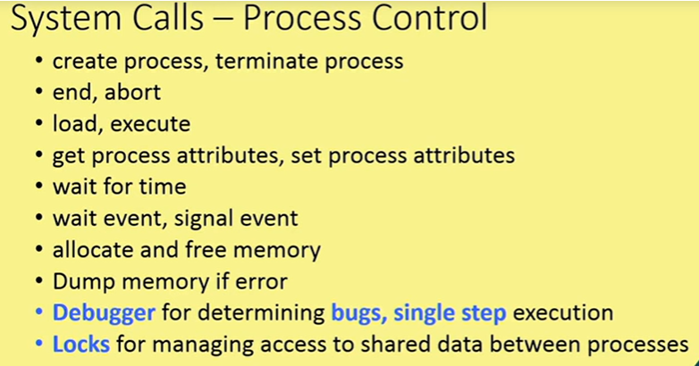
Types of system calls
Dept. of CSE(CS), MSRIT

Slide 21
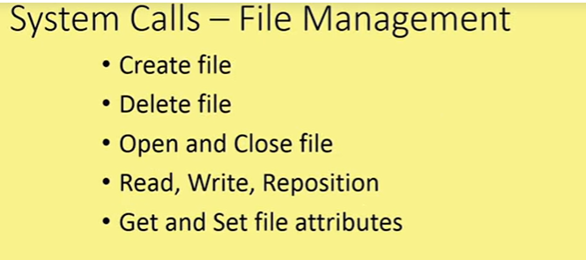
Types of system calls
Dept. of CSE(CS), MSRIT

Slide 22
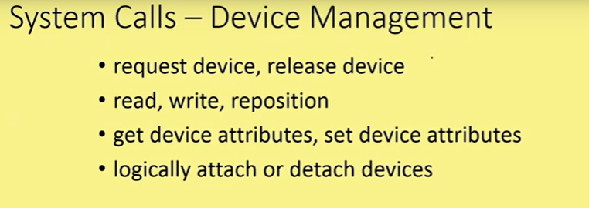
Types of system calls
Dept. of CSE(CS), MSRIT

Slide 23
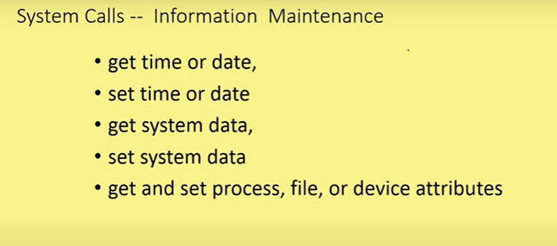
Types of system calls
Dept. of CSE(CS), MSRIT

Slide 24
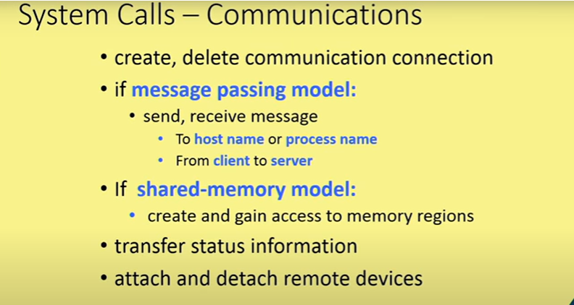
Types of system calls
Dept. of CSE(CS), MSRIT

Slide 25
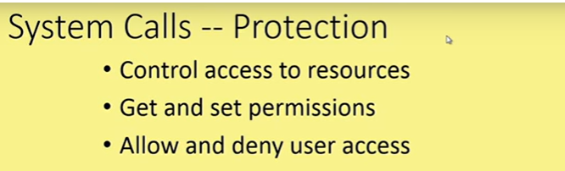
Types of system calls
Dept. of CSE(CS), MSRIT

Slide 26
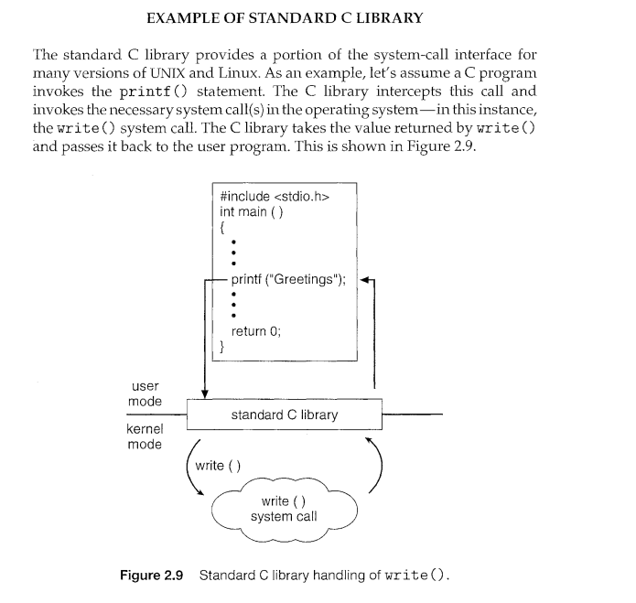
Types of system calls
Dept. of CSE(CS), MSRIT

Slide 27
System Boot
When power initialized on system, execution starts at a fixed memory location
** Firmware ROM used to hold initial boot code
Operating system must be made available to hardware so hardware can start it
** Small piece of code-bootstrap loader, stored in ROM or EEPROM locates the kernel, loads
it into memory, and starts it.
** Sometimes two step process where boot block at fixed location loaded by ROM code,
which loads bootstrap loader from disk.
Common bootstrap loader, GRUB, allows selection of kernel from multiple disks, versions, kernel options.
Kernel loads and system is then running.
Dept. of CSE(CS), MSRIT

Slide 28
Operating System Structures
A modern operating system is divided into small, well-defined modules instead of being
built as one large monolithic system. Each module has clearly defined inputs, outputs,
and specific functions, making the system easier to design, manage, and modify.
Integration into the Kernel – These individual modules are interconnected and combined
to form the operating system kernel. Proper organization and interaction among
components ensure that the entire system functions correctly and efficiently.
Dept. of CSE(CS), MSRIT

Slide 29
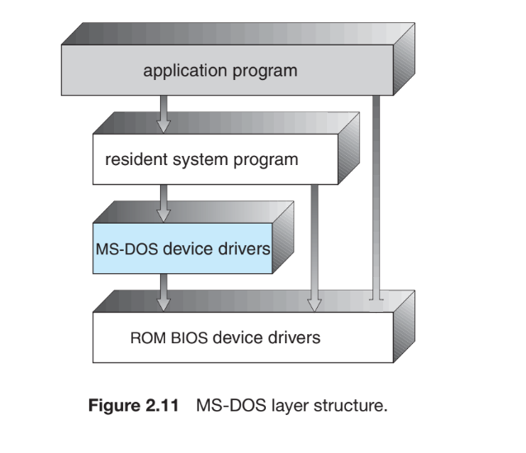
Operating System Structures
Simple Structure:
Dept. of CSE(CS), MSRIT

Slide 30
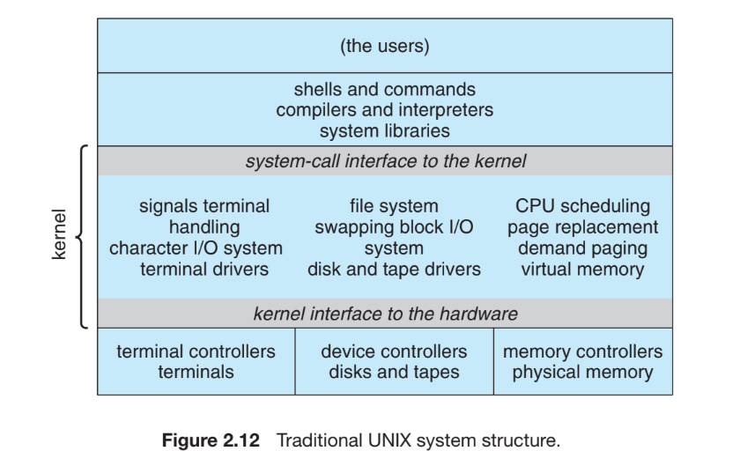
Operating System Structures
Simple Structure:
Dept. of CSE(CS), MSRIT

Slide 31
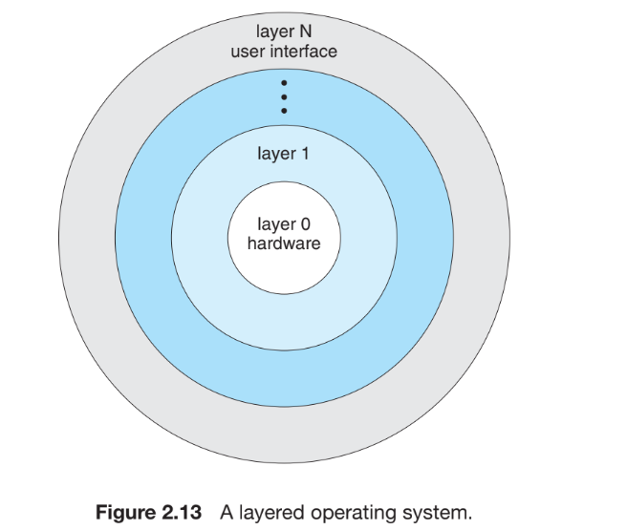
Operating System Structures
Layered Approach:
Dept. of CSE(CS), MSRIT

Slide 32
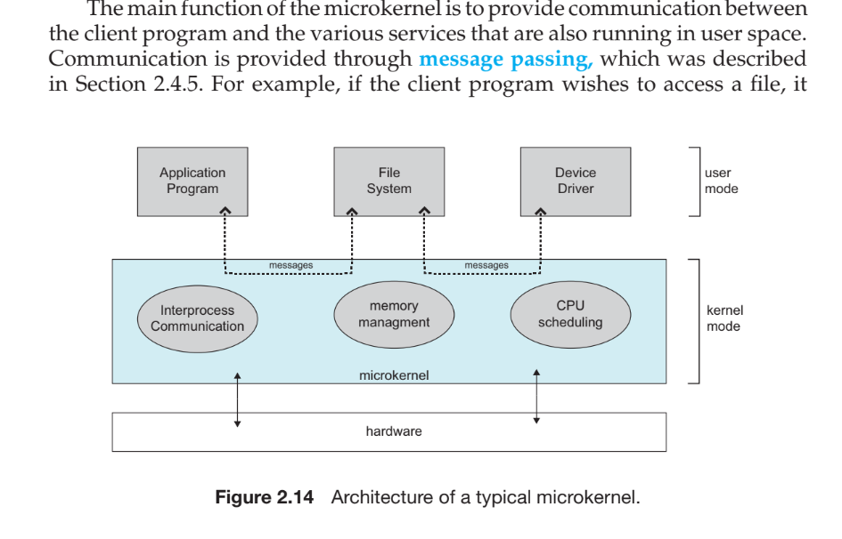
Operating System Structures
Microkernel Approach:
Dept. of CSE(CS), MSRIT

Slide 33
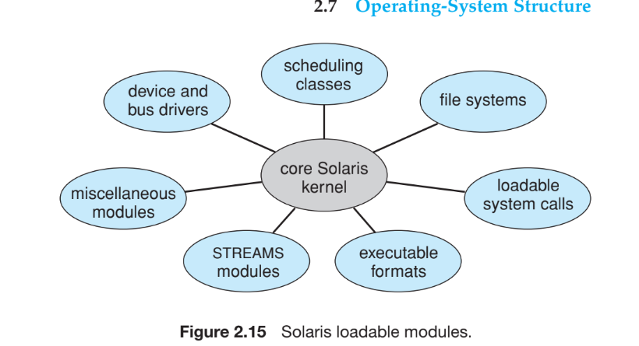
Operating System Structures
Modules:
Dept. of CSE(CS), MSRIT

Slide 34
Operating System Structures
Modules:
The Solaris operating system structure, shown in Figure 2.15, is organized around a core kernel with seven types of loadable kernel modules:
1. Scheduling classes
2. File systems
3. Loadable system calls
4. Executable formats
5. STREAMS modules
6. Miscellaneous
7. Device and bus drivers
Dept. of CSE(CS), MSRIT

Slide 35
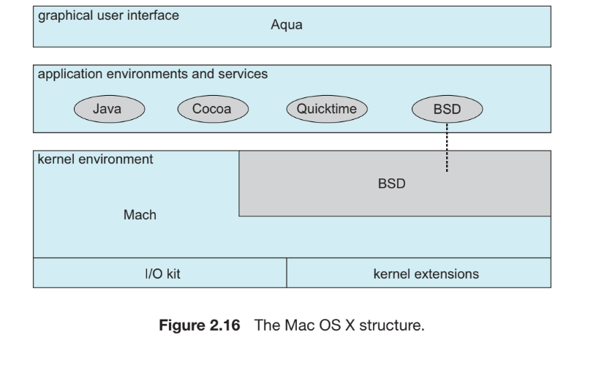
Operating System Structures
Hybrid Systems:
Mac OSx
Dept. of CSE(CS), MSRIT

Slide 36
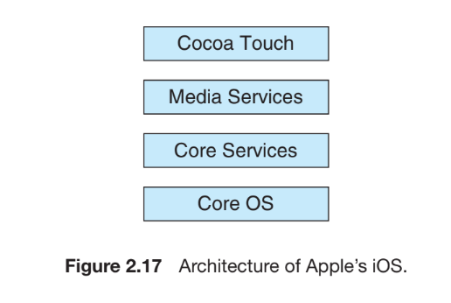
Operating System Structures
Hybrid Systems:
iOS
Dept. of CSE(CS), MSRIT

Slide 37
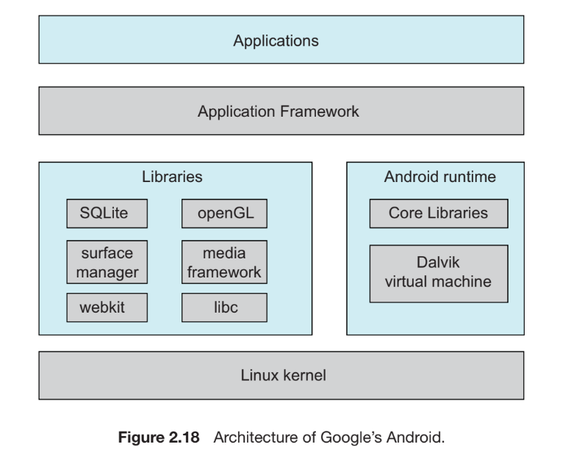
Operating System Structures
Hybrid Systems:
Google’s Android
Dept. of CSE(CS), MSRIT

Slide 38
Thank You
Dept. of CSE(CS), MSRIT

